Slide 1




Insurance Analytics

Slide 2
1. Pilli Venkata Dharani
2. Ninar Vennela
3. Mogasala Nihitha
4. Shivam Gupta
5. Shashank An
6. Muthe DevikaSai
7. Phalak Ahmed
Group: 4

Slide 3


Slide 4
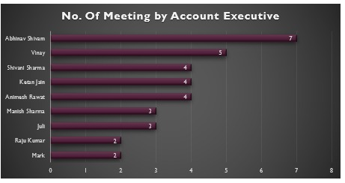
It shows the number of client meetings conducted by each Account Executive.
Highlights individual engagement and sales effort levels.
It helps to identify high-performing and low-performing executives.
Supports performance evaluation and workload analysis.

Slide 5
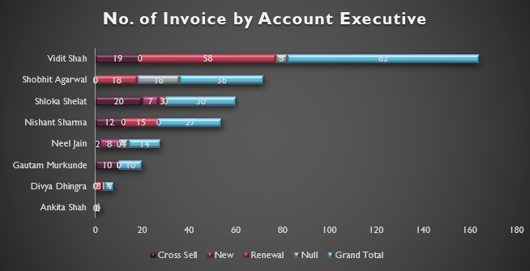
The chart displays the number of invoices generated by each Account Executive.
It breaks down invoices into Cross-Sell, New, and Renewal categories.
Highlights individual contribution to revenue generation.
It helps to measure sales productivity and billing performance.

Slide 6
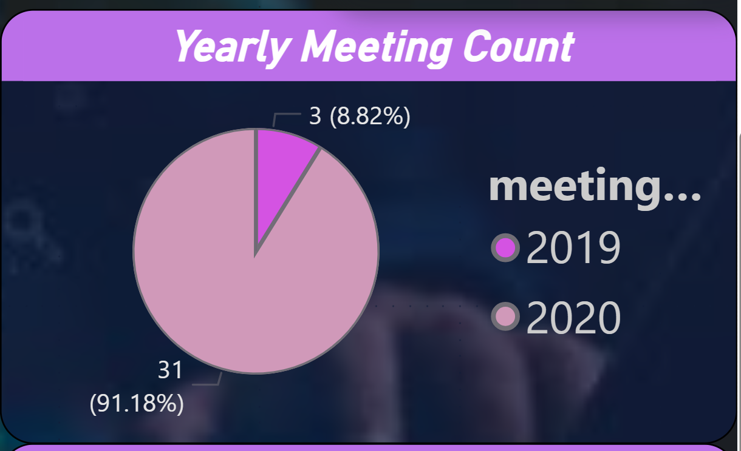
The Pie chart compares total meetings conducted across two years.
Shows year-on-year change in client engagement.
It helps to understand business activity growth trend.
Highlights improvement in sales efforts over time.

Slide 7
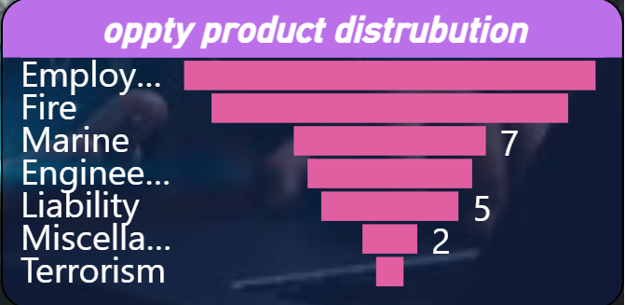
The chart shows the distribution of opportunities across different insurance products.
Highlights products generating the highest business opportunities.
It helps to identify high-demand and low-demand insurance segments.
Supports product-focused sales and marketing strategy.

Slide 8
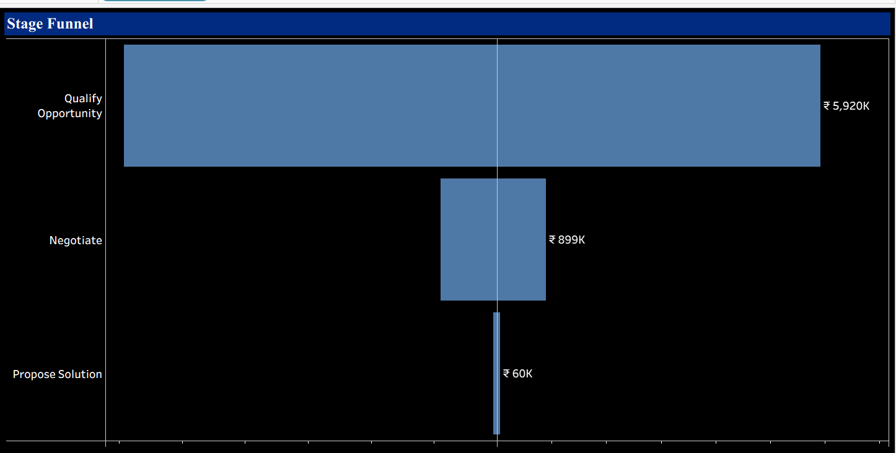
The Funnel chart visualizes the flow of opportunities across sales stages.
It shows value drop-off from qualification to proposal stage.
It helps to identify conversion gaps in the sales pipeline.
Supports better forecasting and pipeline optimization.

Slide 9
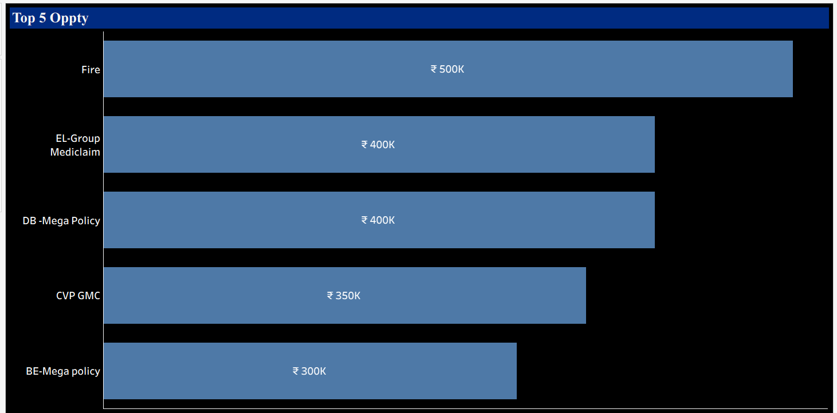
The chart highlights the top 5 opportunities by business value.
Shows revenue contribution from key insurance products.
It helps to identify high-priority opportunities.
Supports strategic decision-making and revenue focus.

Slide 10
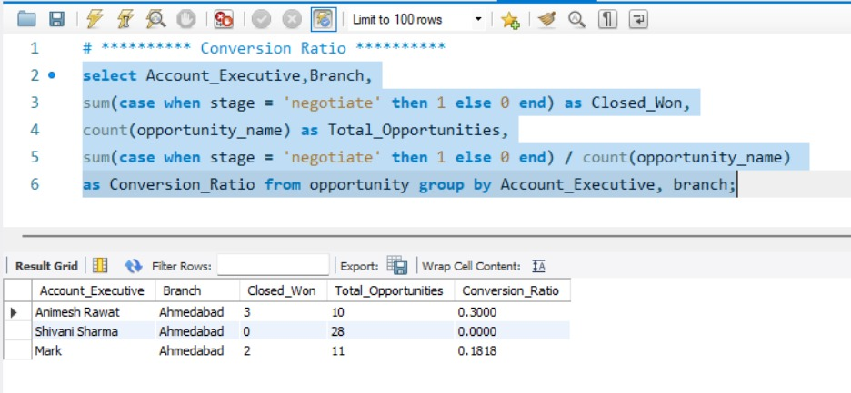
The query find opportunities for each Account Executives Closed_Won and compare it with their total opportunities.

Slide 11
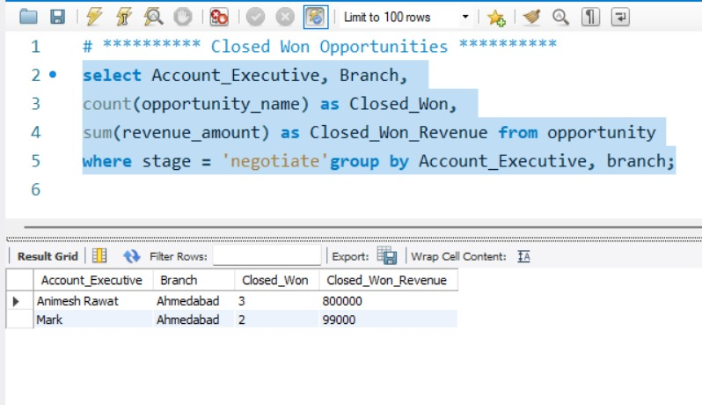
This query identifies all opportunities in the negotiate stage and groups them by Account Executive and Branch.

Slide 12
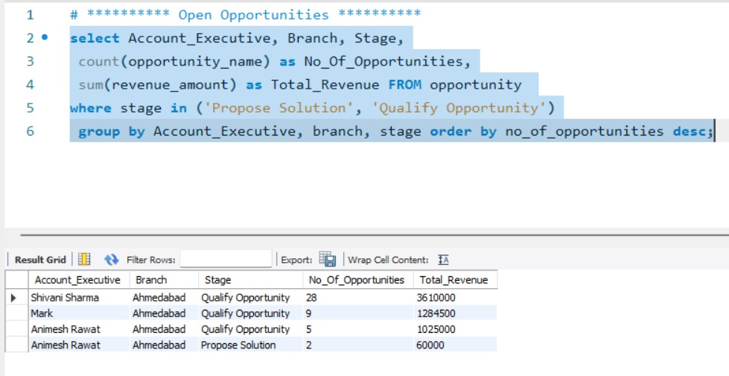
This query filters only Open stages and Count how many opportunities are pending for each Account Executive and Branch.

Slide 13
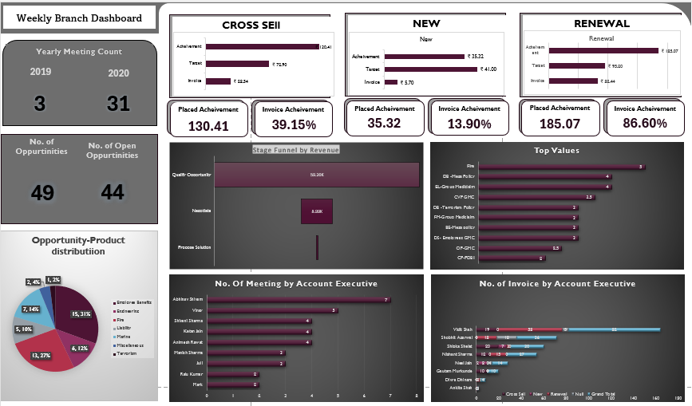
EXCEL Dashboard

Slide 14
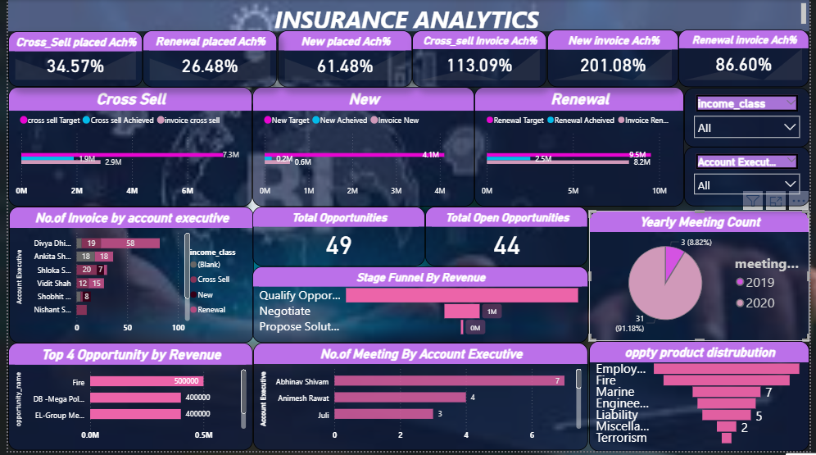
Power bi dashboard

Slide 15
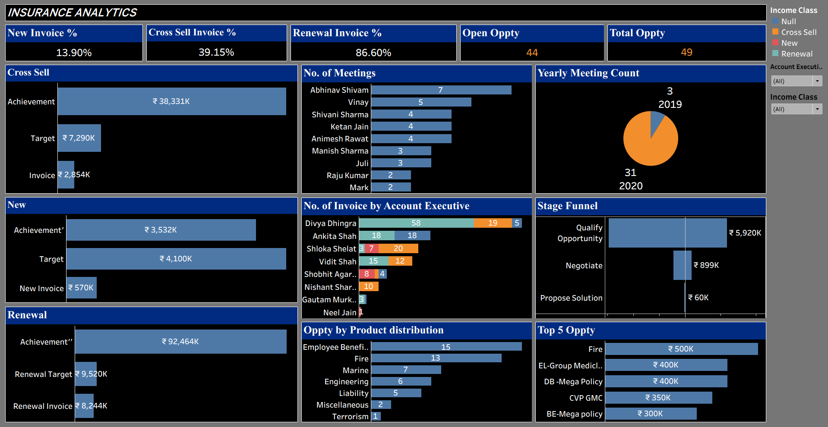
Tableau dashboard

Slide 16
Conclusion
In conclusion, this Insurance Analytics project demonstrates how data can be transformed
actionable business insights using Excel, SQL, Power BI, and Tableau.
By analyzing sales performance, targets, and customer opportunities, this project enables
smarter decision-making, improved efficiency, and revenue growth.
Overall, this project highlights the importance of data analytics in driving strategic
success in the insurance industry.

Slide 17
Thank you

